Slide 1
Making powerful science: an introduction to NGS experimental design
Ass Prof Adam Cribbs
Group leader in systems biology
Botnar Research Centre

Slide 2



A brief history
Student
Postdoc
Assistant prof
Associate prof
2013
2015
2018
2021
MRC Career Development Award
Completed PhD
Development of multi-modal single-cell sequencing technology and its application to Multiple Myeloma
Prof Fionula Brennan
Molecular Immunology
MRC Career Development Award
Postdoctoral scientist
Group Leader in Systems Biology
Prof Udo Oppermann
Prof Marc Feldmann
Th17 cells in autoimmunity
Prof Chris Ponting
Computational Biology
Leading computational team in Oppermann group

Slide 3









Research background
Cancer
Understand primary and secondary bone cancer pathogenesis and identify druggable targets for therapy
Systems Biology
Understanding disease from a functional genomics standpoint
Single-cell sequencing
The development of single-cell technologies and their application to disease
Notes:
Computational biologist get to work across different disciplines
Collaborate with scientists outside my main field of interest. where I can bring the data analytic skills I have and apply them to new disease areas.
However, my main scientific focus is understanding primary and secondary bone cancers.
At the heart of what the group wants to achieve is treatments for these types of cancers. The way the group attempts to tackle this is by understanding disease from a functional genomic standpoint. However, the lack of relevant genomic assays to understand disease hampers this progress. So a big focus for the group is developing novel single-cell assays to help understand this.
Im just giving you a selection here of projects over the past 2 years in which I have built upon the my skills as both a wet-lab and computational biologist. If I hadn't had the computational training I really dont think my research would have been as productive as it is now.

Slide 4
Purpose of this section
I regularly get questions regarding sample design and why other bioinformaticians cant analyse their data, after they have performed the experiment
Good experimental design is crucial for success (confounding effects)
I will discuss the important aspects of good NGS experimental design

Slide 5
Good experimental design
Improves your chances of success
Saves a LOT of money
Obtains meaningful results
Easier when you come to publish your paper

Slide 6
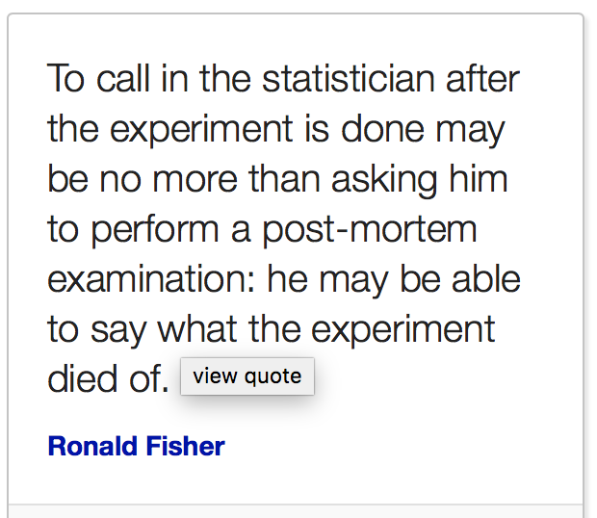
Ronald A Fischer

Slide 7
Planning is critical for an experiment
Rushing into an experiment leads to failure
80% chance of an NGS experiment working is determined before you even touch a pipette

Slide 8
A serious issue in public data
I have seen so much bad data and poorly designed experiments
Almost 70% of samples do not have biological replicates (Feng et al 2012)
ENCODE guidelines require only 2 biological replicates, this is controversial and too few

Slide 9
Specificity and power
Specificity: the proportion of results that are genuine, as opposed to false positives (type I error)
At FDR of 5%, 5 in every 100 results will be wrong
Power (sensitivity): the proportion of real results that are successfully identified in an experiment
With an 80% power, you will successfully identify 800 out of 1000 genuinely DE genes.
Power is often overlooked in experimental design

Slide 10
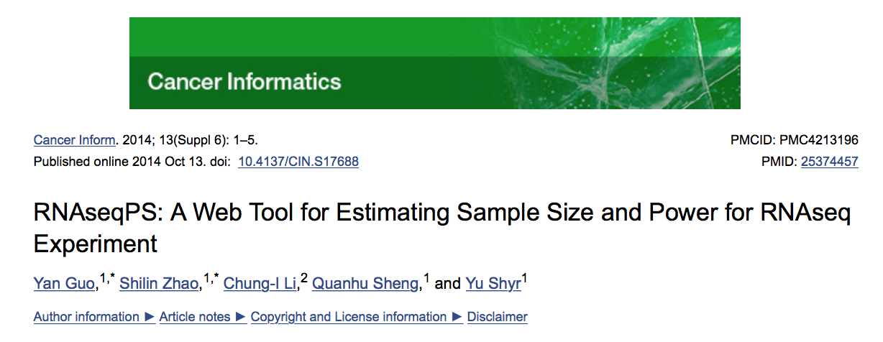
Power calculations
Power calculations are very important!
Pilot data is important for determining this
https://cqs.mc.vanderbilt.edu/shiny/RnaSeqSampleSize/

Slide 11
Adequately powered
Too many samples:
Wastes resources and time
Too few samples:
May lack power leading to unreliable results

Slide 12
How much power is enough power
Depends on the purpose of experiment
Just want to look at top expressed genes = not much
To get a comprehensive list of targets = a lot
Power expressed transcripts = a lot
Rare variants = a lot
Depends on the variability of the sample
Human samples = very variable
Mouse studies = less variable
Immunology = less variable
Cancer = very variable

Slide 13
How many replicates?

Slide 14
Cell line replicates
https://www.slideshare.net/jelena121/introduction-to-ngs-experimental-design?qid=7d0acf70-8728-47ee-ad2d-3f473dea0de8&v=&b=&from_search=1

Slide 15
How many replicates?
The sensitivity, ability or power to detect changes depends on the sample size
Sample size calculator: https://cqs.mc.vanderbilt.edu/shiny/RnaSeqSampleSize/
However, we live in the real world and there are other factors:
The money
What is the effect size
Is it representative of the population
Large enough for meaningful results?

Slide 16
How many replicates?
Studies without replicates make everyone cry
Unless:
It’s a pilot study – to estimate data quality
Its performed on a homogenous tissue – cell line
It’s a simple confirmatory experiment

Slide 17
Minimum number of replicates
Minimum = 3 (cant compute s.d. on less than 3)
Lets you fit statistical distribution more accurately
My recommended minimum = 4/5
Allows for failure of a few
However, it depends on the experiment and other factors discussed before
Failure and improves specificity and sensitivity

Slide 18
To determine the correct number of replicated for an experiment you should perform a power calculation

Slide 19
Statistical power
If there really is a difference (or correlation or association), you might not find it.
It depends on the power of your experiment.

Slide 20
Definitions of power and beta
Even if the treatment really does affect the outcome you may not obtain a significant difference
Just by chance your P value may be > 0.05
Power is the fraction of experiments that you expect to yield a "statistically significant" P value. If your experimental design has high power, then there is a high chance that your experiment will find a "statistically significant" result if the treatment really works.
Notes:
Let's assume we are comparing two means with a t test. Assume that the two means truly differ by a particular amount, and that you perform many experiments with the same sample size. Each experiment will have different values (by chance) so each t test will yield different results. In some experiments, the P value will be less than alpha (usually set to 0.05), so you call the results statistically significant. In other experiments, the P value will be greater than alpha, so you will call the difference not statistically significant.

Slide 21
Definitions of power and beta
Power can range from 0-1 or 0% - 100%
Mathematically power is 1 – beta
Beta is the chance of not rejecting the null hypothesis – i.e. a Type II error
Beta is usually set to 0.2
If there really is a difference between groups, then beta is the probability that an experiment will yield a "not statistically significant" result.
Notes:
Let's assume we are comparing two means with a t test. Assume that the two means truly differ by a particular amount, and that you perform many experiments with the same sample size. Each experiment will have different values (by chance) so each t test will yield different results. In some experiments, the P value will be less than alpha (usually set to 0.05), so you call the results statistically significant. In other experiments, the P value will be greater than alpha, so you will call the difference not statistically significant.

Slide 22
How much power?
If the power is less than 50% to detect some effect that you think is worth detecting, then the study is really not helpful.
Many investigators choose sample size to obtain a 80% power. This is arbitrary, but commonly used.
Ideally, your choice of acceptable power should depend on the consequence of making a Type II error.
Notes:
You've made a type II error when there really is a difference (association, correlation) overall, but random sampling caused your data to not show a statistically significant difference. So your conclusion that the two groups are not really different is incorrect.

Slide 23
Type I and II error
When you make a conclusion you can be wrong in two ways:
Type I error: There really is no difference but random sampling caused your data to show a significance – false positive
Type II error: There really is a difference but random sampling caused your data not to show a significance – false negative
Notes:
You've made a type II error when there really is a difference (association, correlation) overall, but random sampling caused your data to not show a statistically significant difference. So your conclusion that the two groups are not really different is incorrect.

Slide 24
Type 0 and II error
Type 0 error: when you get the right answer but asked the wrong question
Type III error: When you correctly determine the significant difference but you predict it in the wrong direction
Notes:
You've made a type II error when there really is a difference (association, correlation) overall, but random sampling caused your data to not show a statistically significant difference. So your conclusion that the two groups are not really different is incorrect.

Slide 25
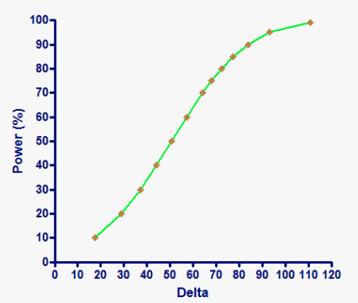
Using power to evaluate a not significant result
What is the power of a study? The answer depends on how large the difference in your measurements are
All studies have a high power to detect "big" differences and a low power to detect "small" differences, so power graph all have the same shape.
In statistics delta just means the change in something
Notes:
You've made a type II error when there really is a difference (association, correlation) overall, but random sampling caused your data to not show a statistically significant difference. So your conclusion that the two groups are not really different is incorrect.

Slide 26
Using power to evaluate a not significant result
Power depends on how large a difference you think would be scientifically or practically important to detect.
Different people may reasonably reach different conclusions.
Note that it doesn't help at all to look up the power of a study to detect the difference we actually observed

Slide 27
How big does and experiment need to be?
The answer, helpfully is, it depends
But what does it depend on?

Slide 28
Sample size determination
An underpowered study is a wasted effort because even substantial treatment effects are likely to go undetected
Even if the treatment substantially changed the outcome, the study would have only a small chance of finding a "statistically significant" effect.

Slide 29
Sample size determination
When planning a study, therefore, you need to choose an appropriate sample size. The required sample size depends on your answers to these questions:
How scattered do you expect your data to be?
How willing are you to risk mistakenly finding a difference by chance?
How big a difference are you looking for?
How sure do you need to be that your study will detect a difference, if it exists? In other words, how much statistical power do you need?

Slide 30
How scattered do you expect the data to be?
Requires that you estimate the standard deviation you expect to see.
If you can't estimate the standard deviation, you can't compute how many subjects you will need.
If you expect lots of scatter, it is harder to discriminate real effects from random noise, so you'll need lots of subjects.

Slide 31
How willing are you to risk finding a difference?
Almost all investigators choose the 5% significance level, meaning that P values less than 0.05 are considered to be "statistically significant".
If you choose a smaller significance level (say 1%), then you'll need more subjects.

Slide 32
Choosing alpha and beta for sample size calculations
When computing sample size, many scientists use standard values for alpha and beta. They always set alpha to 0.05, and beta to 0.20 (which allows for 80% power).
The advantages of the standard approach are that everyone else does it too and it doesn't require much thinking. The disadvantage is that it doesn't do a good job of deciding sample size

Slide 33
Power calculator for RNA-seq and single-cell RNA-seq
Bulk RNA-seq: https://cqs-vumc.shinyapps.io/rnaseqsamplesizeweb/
Single-cell RNA-seq: https://alexdavisscs.shinyapps.io/scs_power_multinomial/

Slide 34
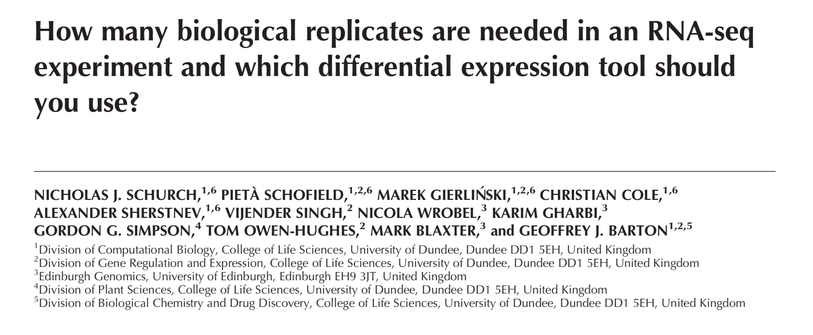
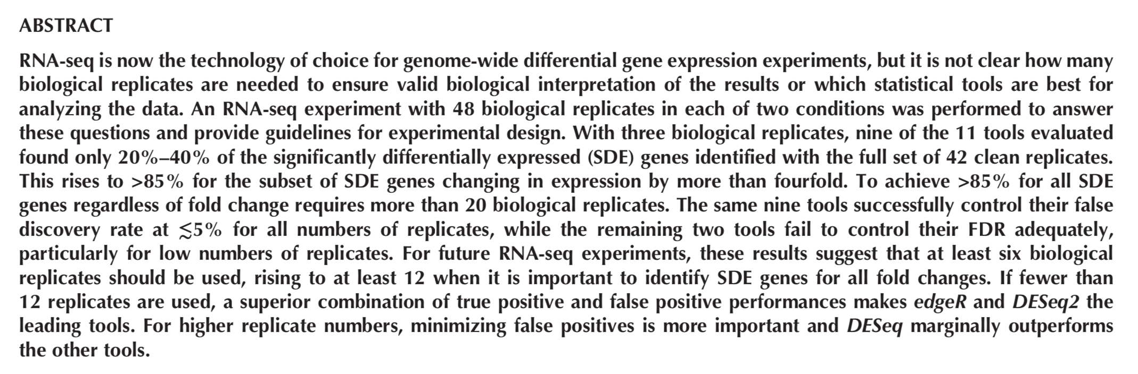
Minimum number of replicates

Slide 35
Precision, accuracy and bias

Slide 36
Precision and accuracy
Bias

Slide 37
Experimental bias
A biased experiment is no different from a useless one
Daniel Sarewitz
(Beware the creeping cracks of bias. Nature, 2012)

Slide 38
Controlling bias
To avoid bias:
Correct selection of experimental conditions
Randomisation of experimental samples
Randomisation in which the order measurements are made
Blinded analysis of the data
Failure to blind can lead to false negative and false positive results

Slide 39
Avoiding confounding factors in RNA-seq
Plate 1
Plate 2
Plate 3
Control
Treatment 1
Treatment 2
Control and treatments are confounded by Plate

Slide 40
Avoiding confounding factors in RNA-seq
Control
Treatment 1
Treatment 2
Plate 1
Plate 2
Plate 3
Control and treatments are confounded by Plate location

Slide 41
Avoiding confounding factors in RNA-seq
Control
Treatment 1
Treatment 2
Plate 1
Plate 2
Plate 3
Day 1
Day 2
Day 3
Control and treatments are confounded by Plate location and day of preperation

Slide 42
Avoiding confounding factors in RNA-seq
Control
Treatment 1
Treatment 2
Plate 1
Plate 2
Plate 3
Day 1
Day 2
Day 3
Control and treatments are confounded by day of preperation

Slide 43
Avoiding confounding factors in RNA-seq
Control
Treatment 1
Treatment 2
Plate 1
Plate 2
Plate 3
Getting better but still have potential confounding effects with plate location

Slide 44
Avoiding bias
Which sampled data is likely biased?
A
B

Slide 45
Avoiding confounding factors in RNA-seq
Control
Treatment 1
Treatment 2
Plate 1
Plate 2
Plate 3
(you get the point that I couldn’t be bothered to draw all the colours)
Unlikely to be a confounded experiment

Slide 46
Sources of bias
Sample collection
Sample preperation
Library prep
Sequencing

Slide 47
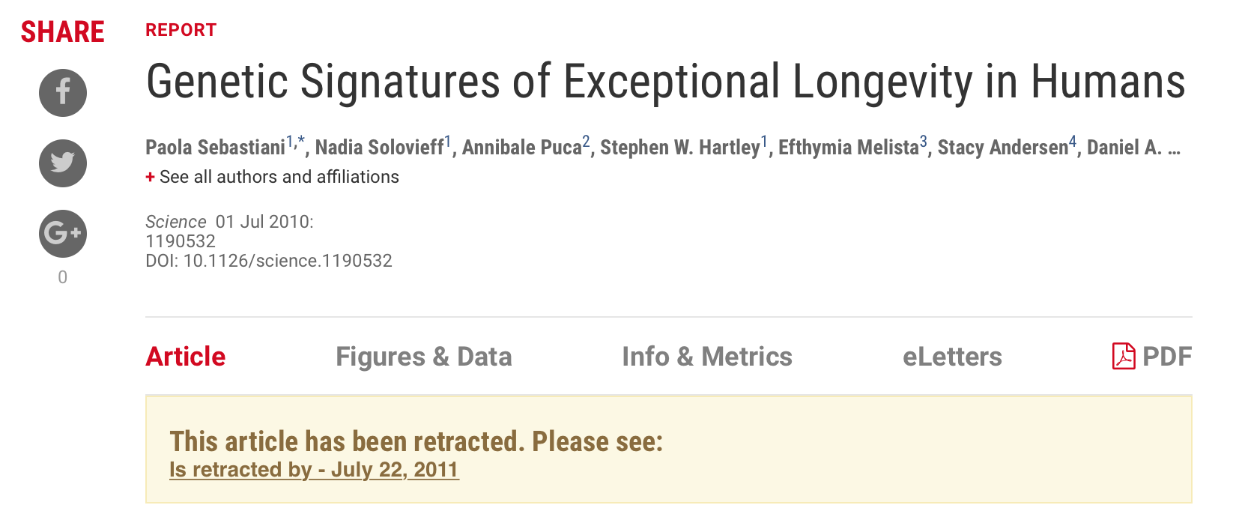
What if you don’t control for bias
Young and old individuals has SNP’s genotypes on different arrays

Slide 48
Correct experimental controls

Slide 49
Experimental controls
Very difficult to avoid all biases – particularly the unknowns (latent variables)
Designing controls is more crucial than the actual things your going to measure
Increases statistical validity of your data
Positive and Negative controls

Slide 50
Experimental controls
Placebo control
Mimic the procedure being performed
E.g. mimic the surgical procedure
Vehicle control
Used in studies where a substance is used to deliver a substance
E.g. empty vector for lentivirus
Baseline biological state

Slide 51
Experimental controls
Most experiments fail because control samples have failed QC
To avoid this, always try to sequence more controls, so if one fails then it avoid total failure
However, too many controls leads to an unbalanced analysis

Slide 52
ChIP-seq controls
ChIP-seq can be extremely noisy
Input DNA is usually used to get a background – however, pros and cons
Replicates: ENCODE uses 2 and performs IDR
I don’t agree, 3 replicates as a minimum

Slide 53
Pooling samples?
Sometimes when you have very little material, pooling of samples is required
Better to pool the biological samples and not RNA or DNA – problems are easier to spot
No way to estimate variation between donors, unless you somehow label (barcode) your samples
Outliers can be a problem and difficult to resolve

Slide 54
Pooling samples?
Sometimes when you have very little material, pooling of samples is required
Better to pool the biological samples and not RNA or DNA – problems are easier to spot
No way to estimate variation between donors, unless you somehow label (barcode) your samples
Outliers can be a problem and difficult to resolve

Slide 55
Considerations when sequencing

Slide 56
NGS parameters to think about
Library size/sequencing depth – number of reads per sample
Typically for RNA-seq and ChIP-seq 20-30 million
Read depth – bp length of each read in the library
Typically 75, but we use 48 to save cost
Single-end vs paired end – sequence one end of the fragment of both ends
Paired end is the standard for most sequencing today

